Slide 1
CSE299: Junior Project Design Design & Development of AGB
Faculty Initial: ITN
Semester: Summer’19
Section: 12
Group-04
Submitted By
Anwar Shadaab (1611383042)
M Saydur Rahman (1520490642)
Kazi Sadia Kabir (1420174042)

Slide 2
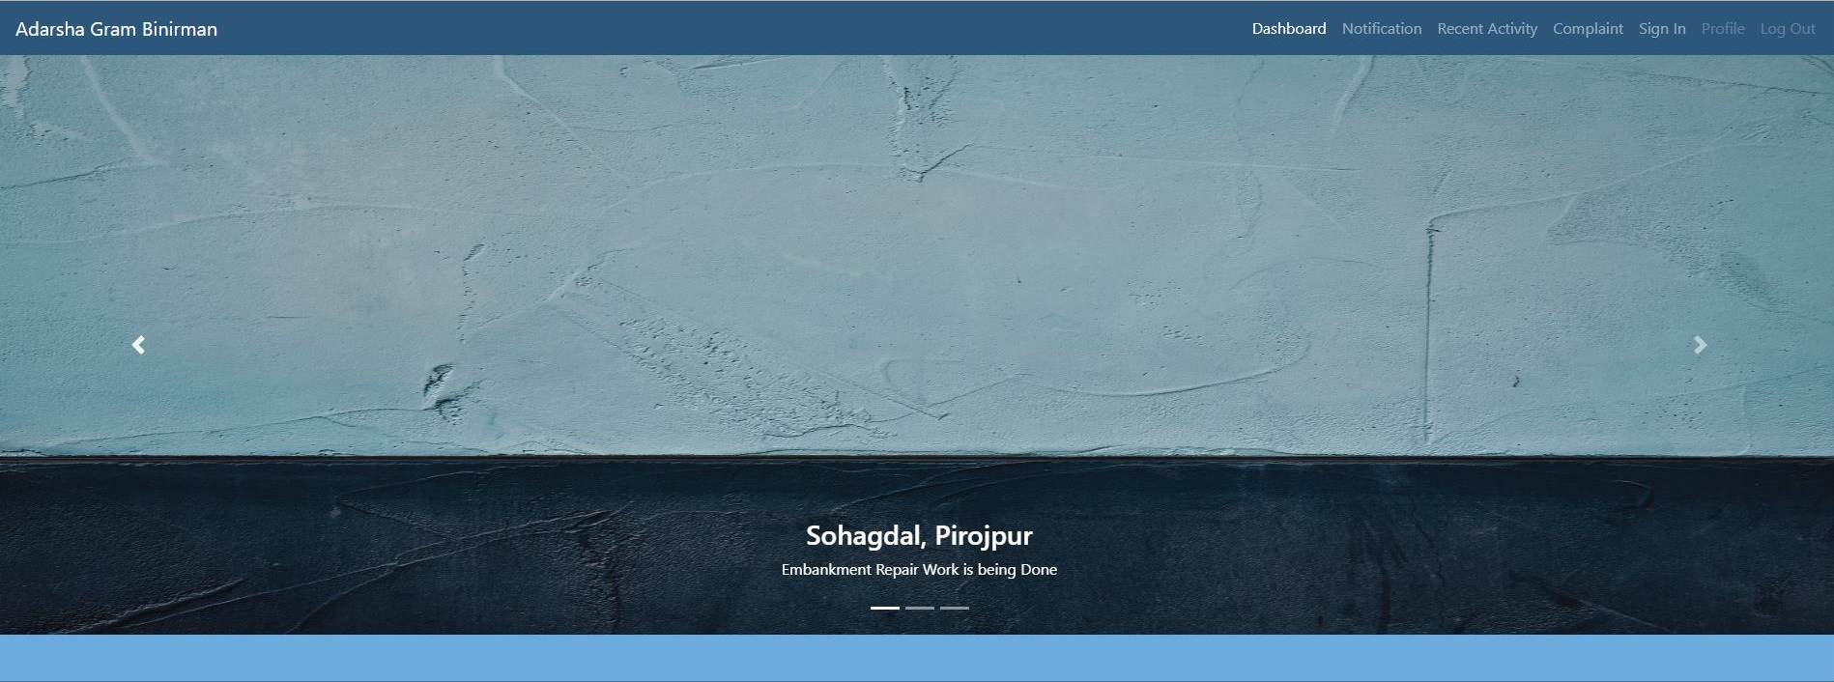
Dashboard #1

Slide 3
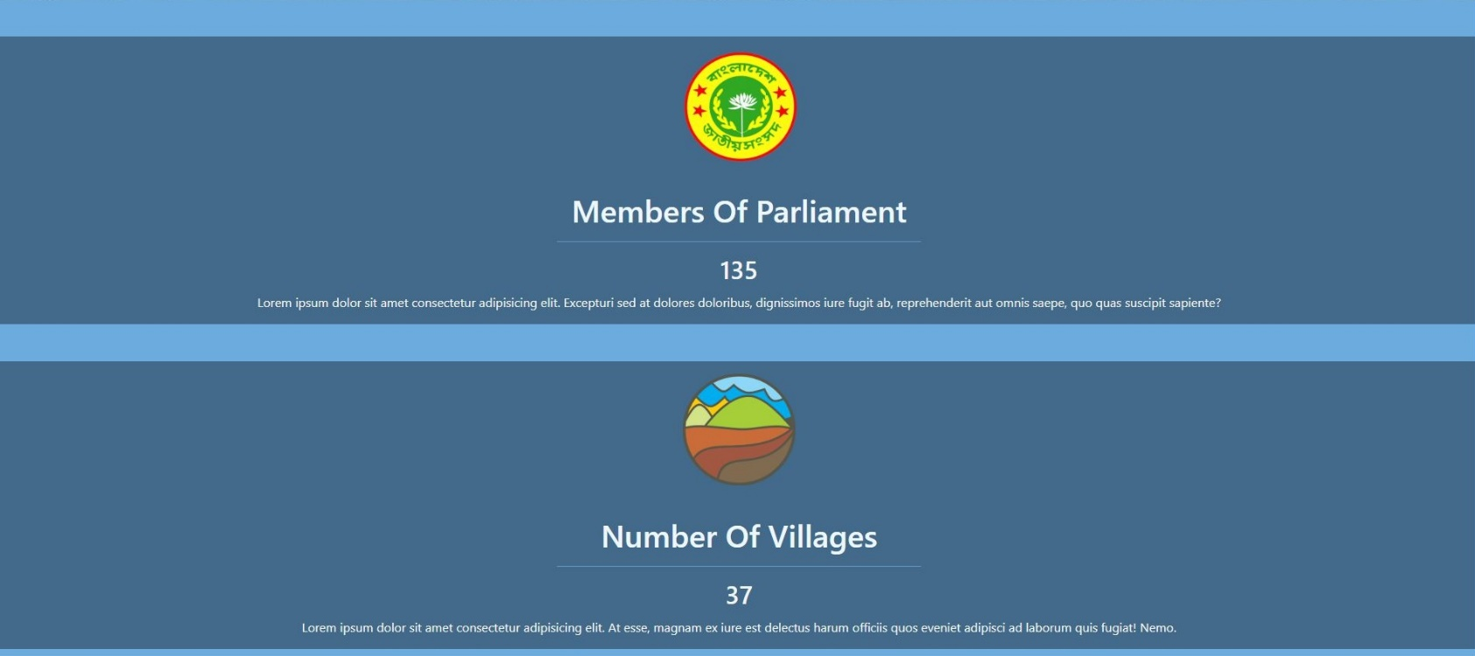
Dashboard #2

Slide 4
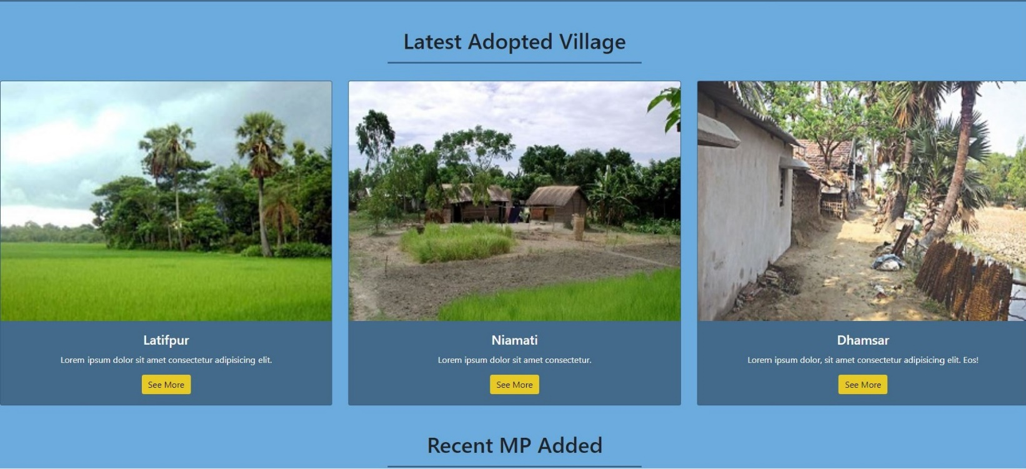
Dashboard #3

Slide 5
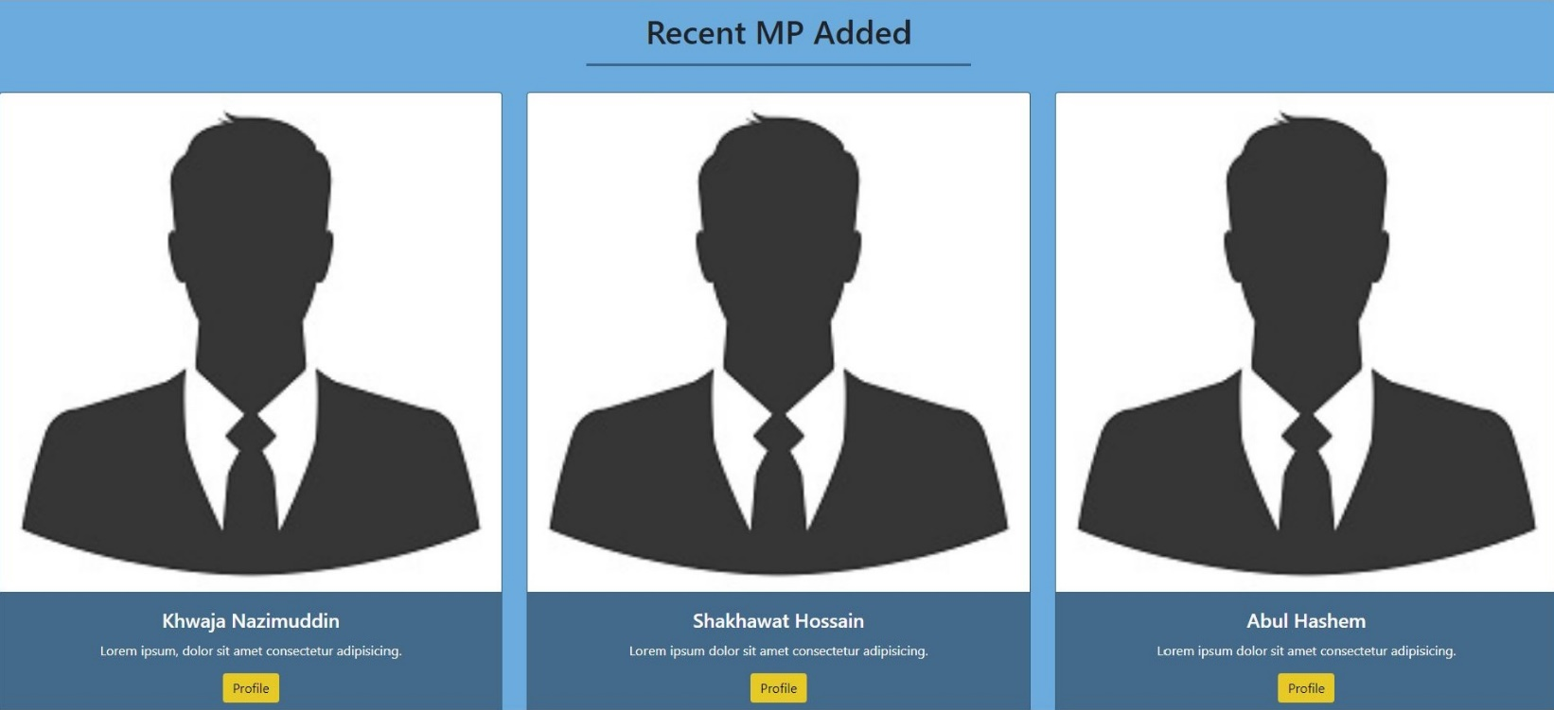
Dashboard #4

Slide 6
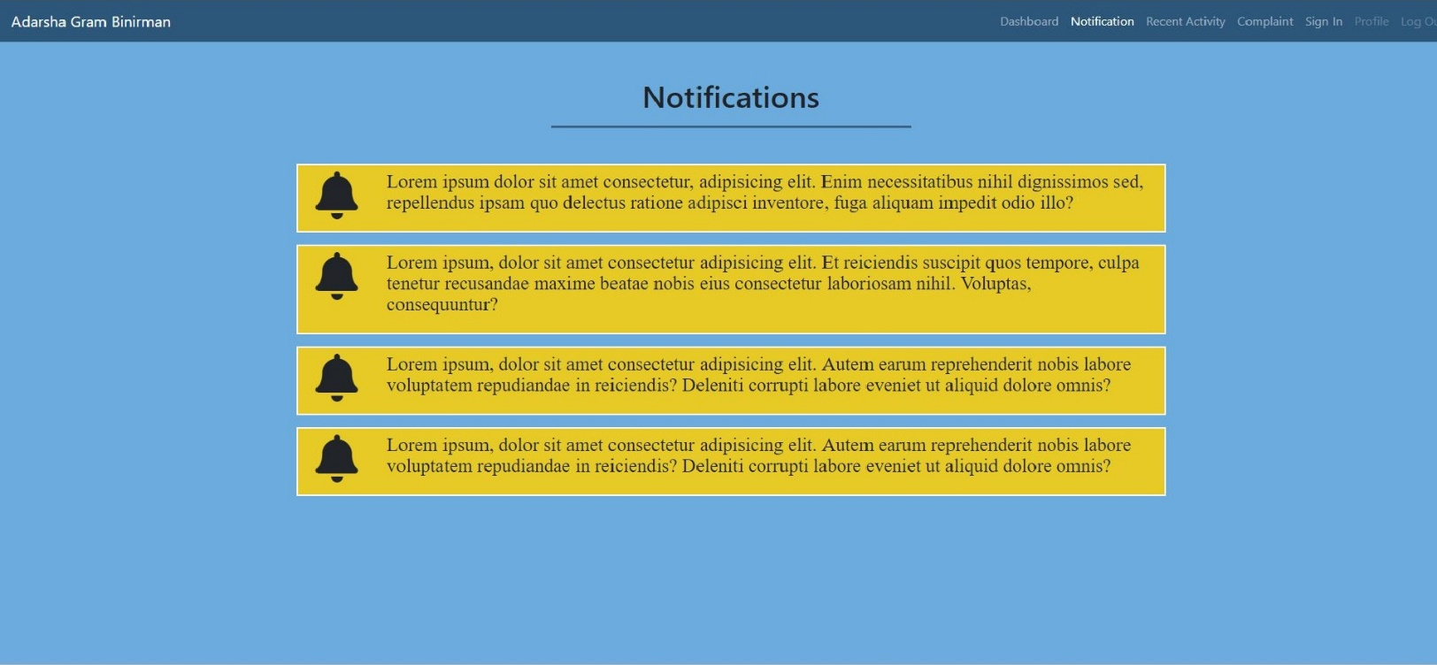
Notification

Slide 7
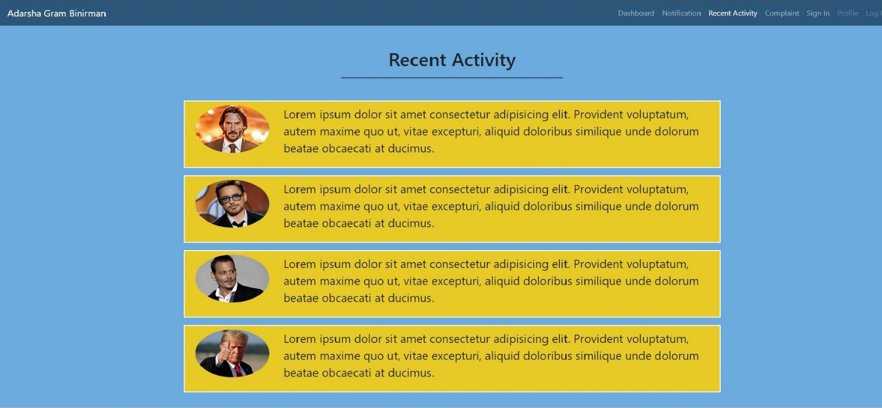
Recent Activity

Slide 8
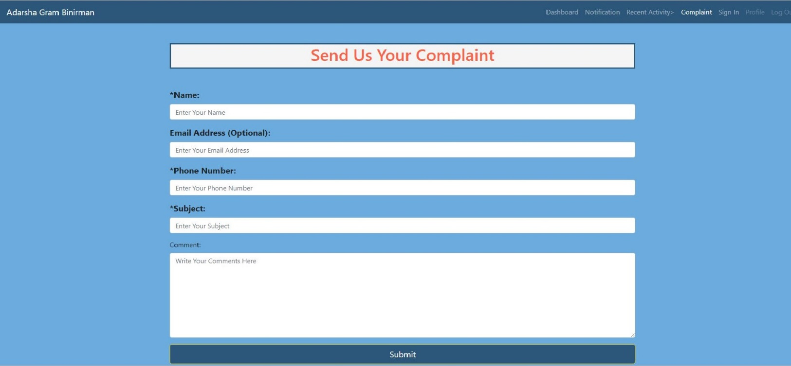
Complaint

Slide 9
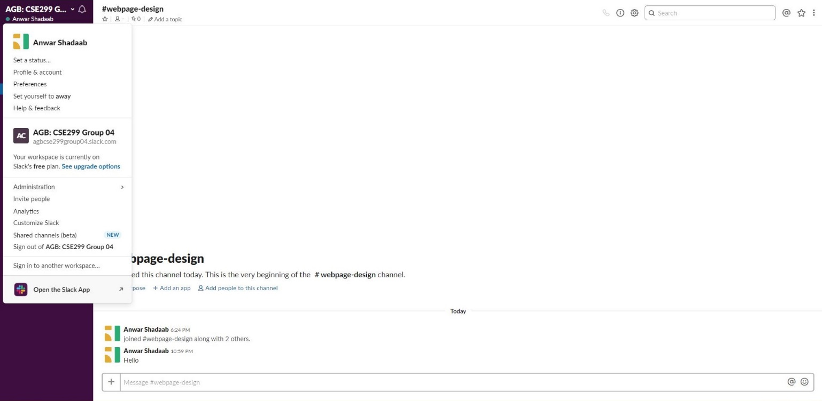
Slack Channel

Slide 10
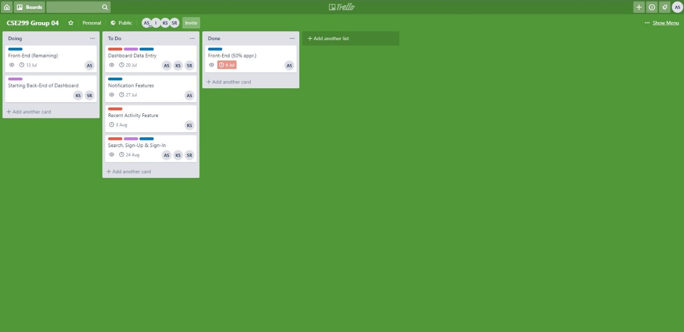
Trello

Slide 11
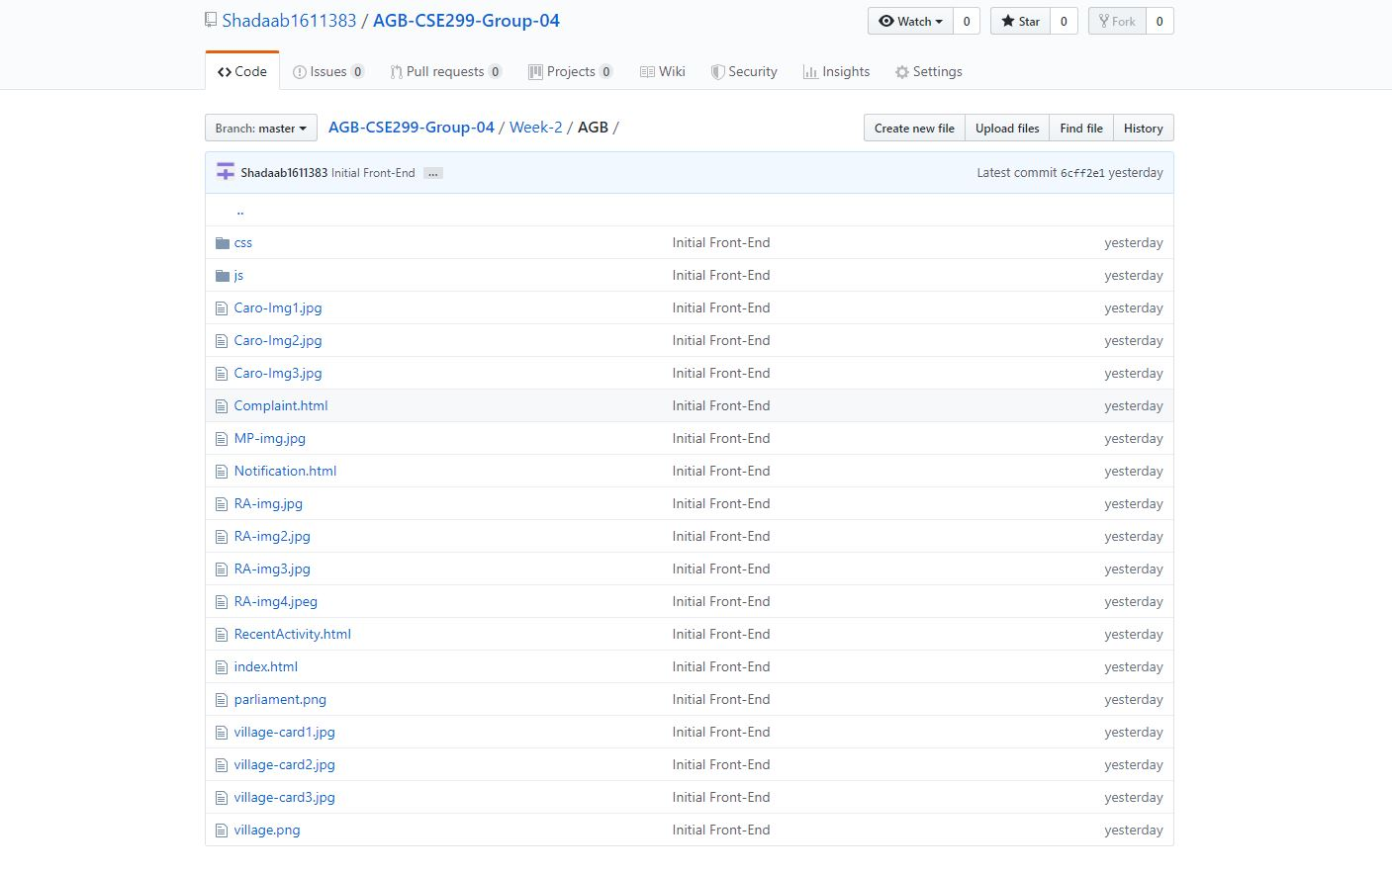
Github

Slide 12
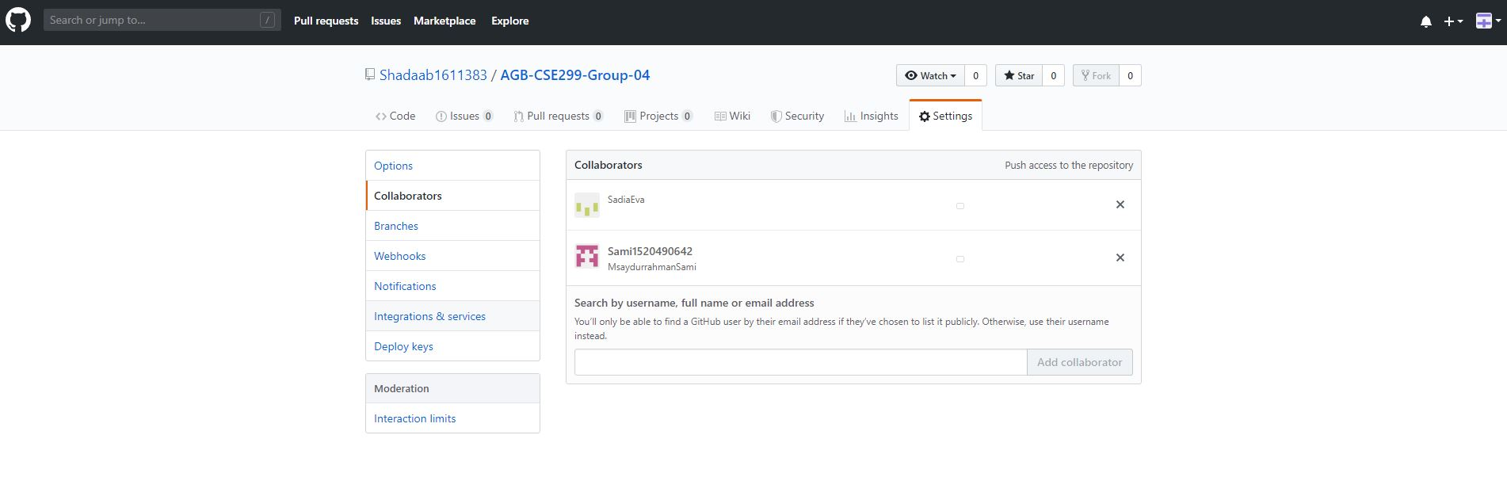
Github #2

